Slide 1

Happiness in europe

Slide 2
introduction
We are Data Thieves hired by the president of the unhappiest country in the world to investigate what makes countries happier, in order to turn the unhappiest country into the happiest country in the world!
For this we stole a dataset from Kaggle with the informations of the Happiness Score, Gdp per Capita, Generosity, Government Trust, Family Social Support, Health Life Expectancy and Freedom to make life choices (all of these, by country and year).
We also got data from Api’s from OMS, about Suicide Rates and Alcohol Consumption by Litres (all of these, by country and year).
We Web Scraped Wikipedia to get the total of Hours of Sun per Year by Country.
And finally, we used a Module from Eurostat to get the Crime Rates per Year by Country.

Slide 3
Project
timeline
Start of the project
Collecting data
Data cleaning
Visualization
Started from a Happiness Report in Kaggle, and from there we decided to add some other metrics
We had to research and find out data about what we wanted to analyze, so we used several tools, such as API’s, Web Scraping and modules ( Eurostat ). From the beginning we used github in order to share files and code.
A lot of data cleaning on all the data, from the Countries we had to normalize for every metric and main database but also for the values for each category
There was plenty to visualize, it was more a matter of what we wanted to show and how to show it, we used matplotlib, seaborn and altair

Slide 4
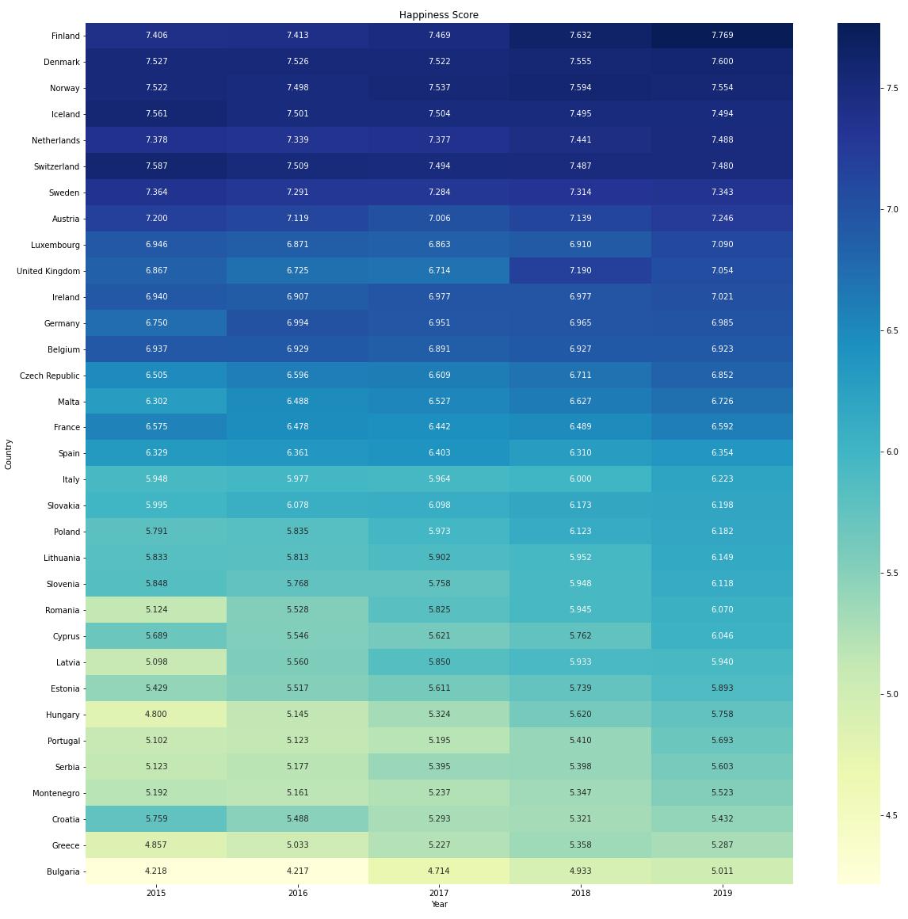

evolution of happiness score
Notes:
Positive correlation: If the number of the correlation is positive. The higher the number, the most it affects
the happiness score making it bigger.
Negative correlation: If the number of the correlation is negative. The lower the number, the most it affects
the happiness score making it smaller.
Basically I'm going to do an analysis on the correlations of every parameter and the happiness score (crucial to
have on the presentation, and then I'm gonna search for correlations above 0.5 and below -0.5, because these
values are not very common in the correlations table and they are worthy of being mentioned if we feel that
they are relevant. There is a small corner case that I'm going to mention about the alcohol and suicides.
I think that before talking about these correlation in the presentation it is important for us to mention that the
happiness score was given by people when asked about how happy they feel from 0 to 10, and our process to create
this correlations matrix (adding the extra parameters that we gathered via API's and Webscraping).
Correlations:
Happiness Score vs GDP - This correlation has a value of aprox. 0.76, which means that the GDP and Hapiness Score
have a HIGH POSITIVE correlation, which makes perfect sense, being money as important as it is in society
to give stability and happiness. Therefore, the GDP contributes a high amount to the increase of the happiness
score.
Happiness Score vs Family Social Support - This correlation has a value of aprox. 0.47, which means a LOW POSITIVE,
almost MODERATE correlation, that indicates that the social support given to family has a slight importance
in the happiness score. This value can be expected to be higher, but we have to consider of course that in Western
Europe countries not everyone needs this kind of support to give stability to their family, therefore it is not
crucial to the increase of the happiness score, but still contributes.
Happiness Score vs Healthy life expectancy - This correlation has a value of aprox. 0.52, which means a MODERATE
POSITIVE correlation with the happiness score. This shows that people care about living longer with quality in
a way that contributes a considerate amount to the increase happiness score.
Happiness Score vs Freedom to make life choices - This correlation has a value of aprox. 0.78, which means a HIGH
POSITIVE correlation with the happiness score. This indicates that people care about the freedom that they have
in society to have plenty of life choices and to be able to make those life choice, and this highly contributes
to the increase of happiness score.
Happiness Score vs Perceptions of corruption - This correlation has a value of aprox. 0.82, which means a HIGH
POSITIVE correlation with the happiness score. This indicates that people care about the trust that they have in
their governments and it highly contributes to the increase happiness score.
Happiness Score vs Generosity - This correlation has a value of aprox. 0.63, which means a MODERATE POSITIVE
correlation with the happiness score. This indicates that people care about the feeling of generosity in their
country, and this contributes a considerate amount to the increase of the happiness score.
Happiness Score vs Alcohol - This correlation has a value of aprox. -0.22, which means a VERY LOW NEGATIVE
correlation, that means that the quantity of alcohol that people consume in each country contributes very lowly
to the decrease of the happiness score.
Happiness Score vs Crime - This correlation has a value of aprox. -0.10, which means a VERY LOW NEGATIVE
correlation, that means that the crime existent in the country contributes very lowly to the descrease of the
happiness score. Again is worth mentioning that we are dealing with countries from Western Europe, that usually
tend to have small tendencies for crime.
Happiness Score vs Suicide - This correlation has a value of aprox. 0.04, which means a NON-EXISTENT correlation
with the happiness score.
Happiness Score vs Hours of Sun - This correlation has a value of aprox. -0.53, which means a MODERATE NEGATIVE
correlation. This correlation means that the hours of sun contribute a moderate amount to the decrease of the
happiness score. This may seem wrong but it makes sense due to the fact of the happiness score being much higher
in countries located in the north of Europe that have much less hours of sun than countries located more towards
the south.
WORHTY MENTIONS:
GDP per capita vs Freedom vs Perceptions of corruption vs Generosity -> There are positive moderate and high
correlations between all of these parameters.
Hours of sun vs Suicide -> There is a moderate negative correlation which means that countries that have less
hours of sun tend to have more suicides and vice-versa.
Suicide vs Alcohol -> There is a very "close to moderate" correlation which means that the countrys that consume
more alcohol tend to have more suicides and vice-versa.

Slide 5
Correlations
positive
Negative
1 - 0.90 -> very high
0.90 - 0.7 -> high
0.7 - 0.5 -> moderate
0.5 - 0.3 -> low
0.3 - 0.10 -> very low
0.10 - 0 -> non-existent
0 - (-0.10) -> non-existent
(-0.3) - (-0.10 )-> very low
(-0.5) - (-0.3) -> low
(-0.7) - (-0.5) -> moderate
(-0.90) - (-0.7) -> high
(-1) - (-0.90) -> very high

Slide 6
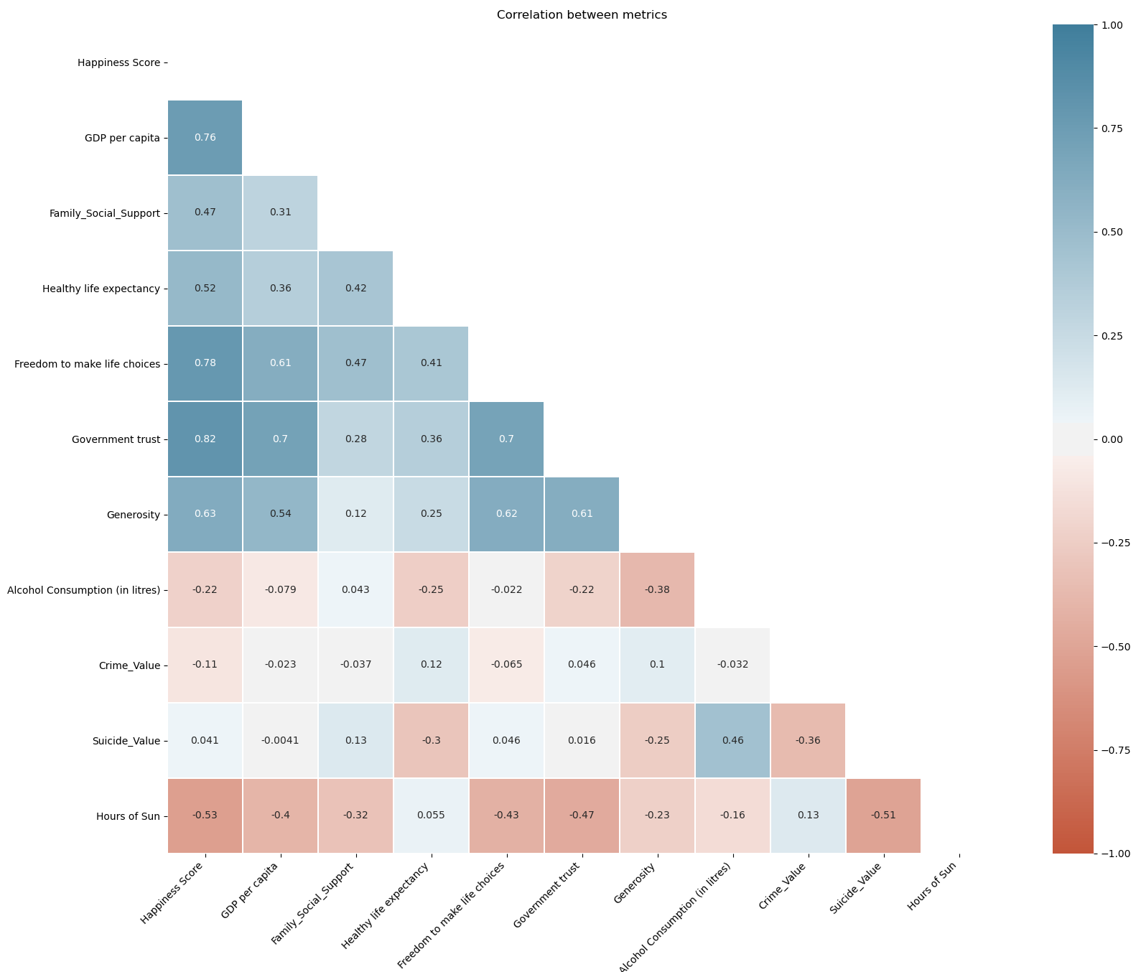
Correlations all parameters
Notes:
Positive correlation: If the number of the correlation is positive. The higher the number, the most it affects
the happiness score making it bigger.
Negative correlation: If the number of the correlation is negative. The lower the number, the most it affects
the happiness score making it smaller.
Basically I'm going to do an analysis on the correlations of every parameter and the happiness score (crucial to
have on the presentation, and then I'm gonna search for correlations above 0.5 and below -0.5, because these
values are not very common in the correlations table and they are worthy of being mentioned if we feel that
they are relevant. There is a small corner case that I'm going to mention about the alcohol and suicides.
I think that before talking about these correlation in the presentation it is important for us to mention that the
happiness score was given by people when asked about how happy they feel from 0 to 10, and our process to create
this correlations matrix (adding the extra parameters that we gathered via API's and Webscraping).
Correlations:
Happiness Score vs GDP - This correlation has a value of aprox. 0.76, which means that the GDP and Hapiness Score
have a HIGH POSITIVE correlation, which makes perfect sense, being money as important as it is in society
to give stability and happiness. Therefore, the GDP contributes a high amount to the increase of the happiness
score.
Happiness Score vs Family Social Support - This correlation has a value of aprox. 0.47, which means a LOW POSITIVE,
almost MODERATE correlation, that indicates that the social support given to family has a slight importance
in the happiness score. This value can be expected to be higher, but we have to consider of course that in Western
Europe countries not everyone needs this kind of support to give stability to their family, therefore it is not
crucial to the increase of the happiness score, but still contributes.
Happiness Score vs Healthy life expectancy - This correlation has a value of aprox. 0.52, which means a MODERATE
POSITIVE correlation with the happiness score. This shows that people care about living longer with quality in
a way that contributes a considerate amount to the increase happiness score.
Happiness Score vs Freedom to make life choices - This correlation has a value of aprox. 0.78, which means a HIGH
POSITIVE correlation with the happiness score. This indicates that people care about the freedom that they have
in society to have plenty of life choices and to be able to make those life choice, and this highly contributes
to the increase of happiness score.
Happiness Score vs Perceptions of corruption - This correlation has a value of aprox. 0.82, which means a HIGH
POSITIVE correlation with the happiness score. This indicates that people care about the trust that they have in
their governments and it highly contributes to the increase happiness score.
Happiness Score vs Generosity - This correlation has a value of aprox. 0.63, which means a MODERATE POSITIVE
correlation with the happiness score. This indicates that people care about the feeling of generosity in their
country, and this contributes a considerate amount to the increase of the happiness score.
Happiness Score vs Alcohol - This correlation has a value of aprox. -0.22, which means a VERY LOW NEGATIVE
correlation, that means that the quantity of alcohol that people consume in each country contributes very lowly
to the decrease of the happiness score.
Happiness Score vs Crime - This correlation has a value of aprox. -0.10, which means a VERY LOW NEGATIVE
correlation, that means that the crime existent in the country contributes very lowly to the descrease of the
happiness score. Again is worth mentioning that we are dealing with countries from Western Europe, that usually
tend to have small tendencies for crime.
Happiness Score vs Suicide - This correlation has a value of aprox. 0.04, which means a NON-EXISTENT correlation
with the happiness score.
Happiness Score vs Hours of Sun - This correlation has a value of aprox. -0.53, which means a MODERATE NEGATIVE
correlation. This correlation means that the hours of sun contribute a moderate amount to the decrease of the
happiness score. This may seem wrong but it makes sense due to the fact of the happiness score being much higher
in countries located in the north of Europe that have much less hours of sun than countries located more towards
the south.
WORHTY MENTIONS:
GDP per capita vs Freedom vs Perceptions of corruption vs Generosity -> There are positive moderate and high
correlations between all of these parameters.
Hours of sun vs Suicide -> There is a moderate negative correlation which means that countries that have less
hours of sun tend to have more suicides and vice-versa.
Suicide vs Alcohol -> There is a very "close to moderate" correlation which means that the countrys that consume
more alcohol tend to have more suicides and vice-versa.

Slide 7
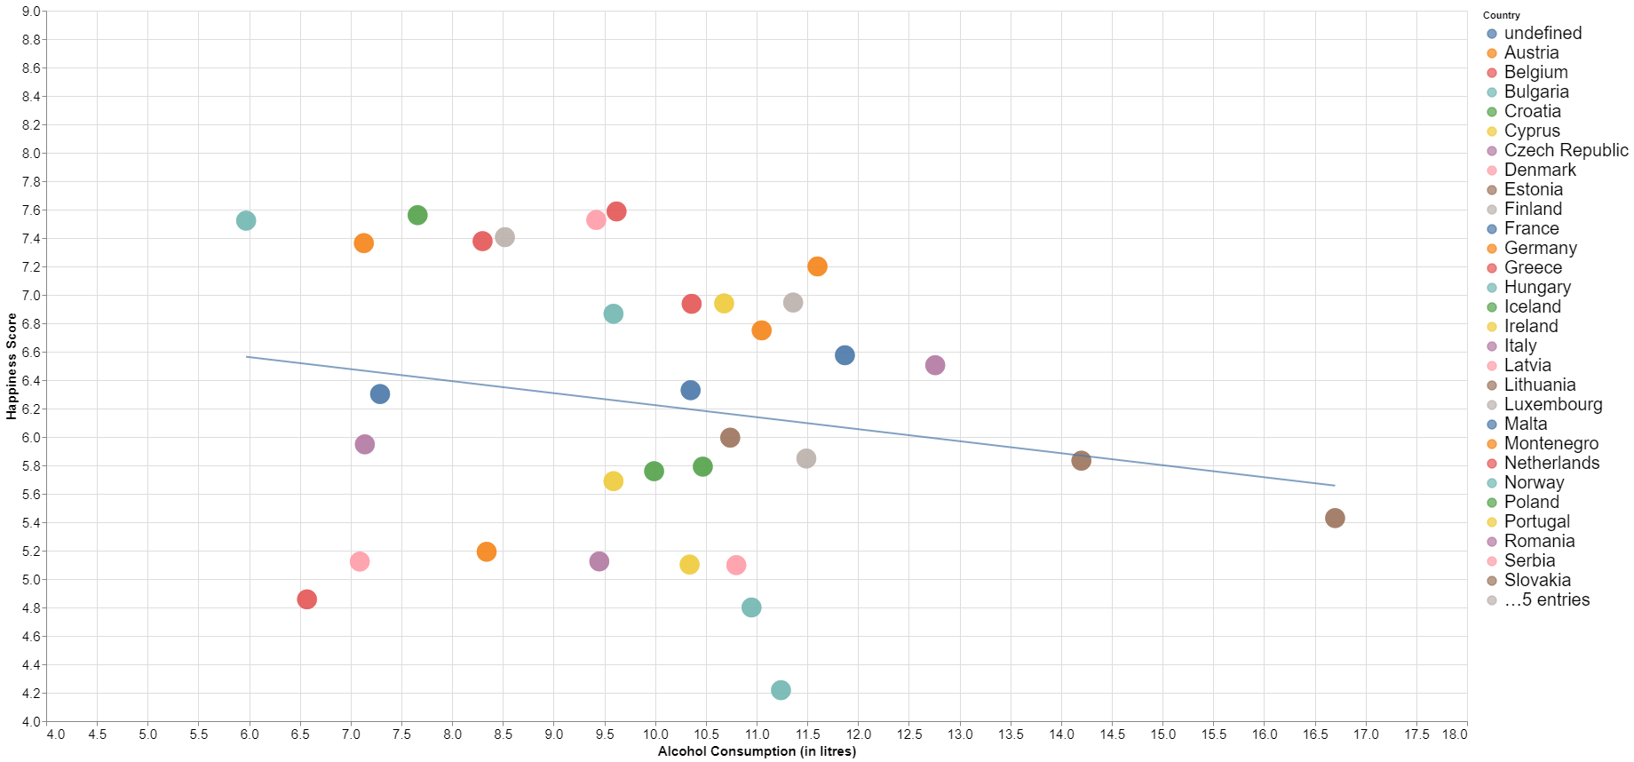
happiness score vs alcohol
The correlation between the two variables is approx -0.22. That represents a very low negative correlation, which means that the unhappier countries have only a slight tendency to consume more alcohol.
Notes:
file:///C:/Users/pedro/Desktop/World-Happiness-Report/Alcohol_Year_Happiness.html
Positive correlation: If the number of the correlation is positive. The higher the number, the most it affects
the happiness score making it bigger.
Negative correlation: If the number of the correlation is negative. The lower the number, the most it affects
the happiness score making it smaller.
Basically I'm going to do an analysis on the correlations of every parameter and the happiness score (crucial to
have on the presentation, and then I'm gonna search for correlations above 0.5 and below -0.5, because these
values are not very common in the correlations table and they are worthy of being mentioned if we feel that
they are relevant. There is a small corner case that I'm going to mention about the alcohol and suicides.
I think that before talking about these correlation in the presentation it is important for us to mention that the
happiness score was given by people when asked about how happy they feel from 0 to 10, and our process to create
this correlations matrix (adding the extra parameters that we gathered via API's and Webscraping).
Correlations:
Happiness Score vs GDP - This correlation has a value of aprox. 0.76, which means that the GDP and Hapiness Score
have a HIGH POSITIVE correlation, which makes perfect sense, being money as important as it is in society
to give stability and happiness. Therefore, the GDP contributes a high amount to the increase of the happiness
score.
Happiness Score vs Family Social Support - This correlation has a value of aprox. 0.47, which means a LOW POSITIVE,
almost MODERATE correlation, that indicates that the social support given to family has a slight importance
in the happiness score. This value can be expected to be higher, but we have to consider of course that in Western
Europe countries not everyone needs this kind of support to give stability to their family, therefore it is not
crucial to the increase of the happiness score, but still contributes.
Happiness Score vs Healthy life expectancy - This correlation has a value of aprox. 0.52, which means a MODERATE
POSITIVE correlation with the happiness score. This shows that people care about living longer with quality in
a way that contributes a considerate amount to the increase happiness score.
Happiness Score vs Freedom to make life choices - This correlation has a value of aprox. 0.78, which means a HIGH
POSITIVE correlation with the happiness score. This indicates that people care about the freedom that they have
in society to have plenty of life choices and to be able to make those life choice, and this highly contributes
to the increase of happiness score.
Happiness Score vs Perceptions of corruption - This correlation has a value of aprox. 0.82, which means a HIGH
POSITIVE correlation with the happiness score. This indicates that people care about the trust that they have in
their governments and it highly contributes to the increase happiness score.
Happiness Score vs Generosity - This correlation has a value of aprox. 0.63, which means a MODERATE POSITIVE
correlation with the happiness score. This indicates that people care about the feeling of generosity in their
country, and this contributes a considerate amount to the increase of the happiness score.
Happiness Score vs Alcohol - This correlation has a value of aprox. -0.22, which means a VERY LOW NEGATIVE
correlation, that means that the quantity of alcohol that people consume in each country contributes very lowly
to the decrease of the happiness score.
Happiness Score vs Crime - This correlation has a value of aprox. -0.10, which means a VERY LOW NEGATIVE
correlation, that means that the crime existent in the country contributes very lowly to the descrease of the
happiness score. Again is worth mentioning that we are dealing with countries from Western Europe, that usually
tend to have small tendencies for crime.
Happiness Score vs Suicide - This correlation has a value of aprox. 0.04, which means a NON-EXISTENT correlation
with the happiness score.
Happiness Score vs Hours of Sun - This correlation has a value of aprox. -0.53, which means a MODERATE NEGATIVE
correlation. This correlation means that the hours of sun contribute a moderate amount to the decrease of the
happiness score. This may seem wrong but it makes sense due to the fact of the happiness score being much higher
in countries located in the north of Europe that have much less hours of sun than countries located more towards
the south.
WORHTY MENTIONS:
GDP per capita vs Freedom vs Perceptions of corruption vs Generosity -> There are positive moderate and high
correlations between all of these parameters.
Hours of sun vs Suicide -> There is a moderate negative correlation which means that countries that have less
hours of sun tend to have more suicides and vice-versa.
Suicide vs Alcohol -> There is a very "close to moderate" correlation which means that the countrys that consume
more alcohol tend to have more suicides and vice-versa.

Slide 8
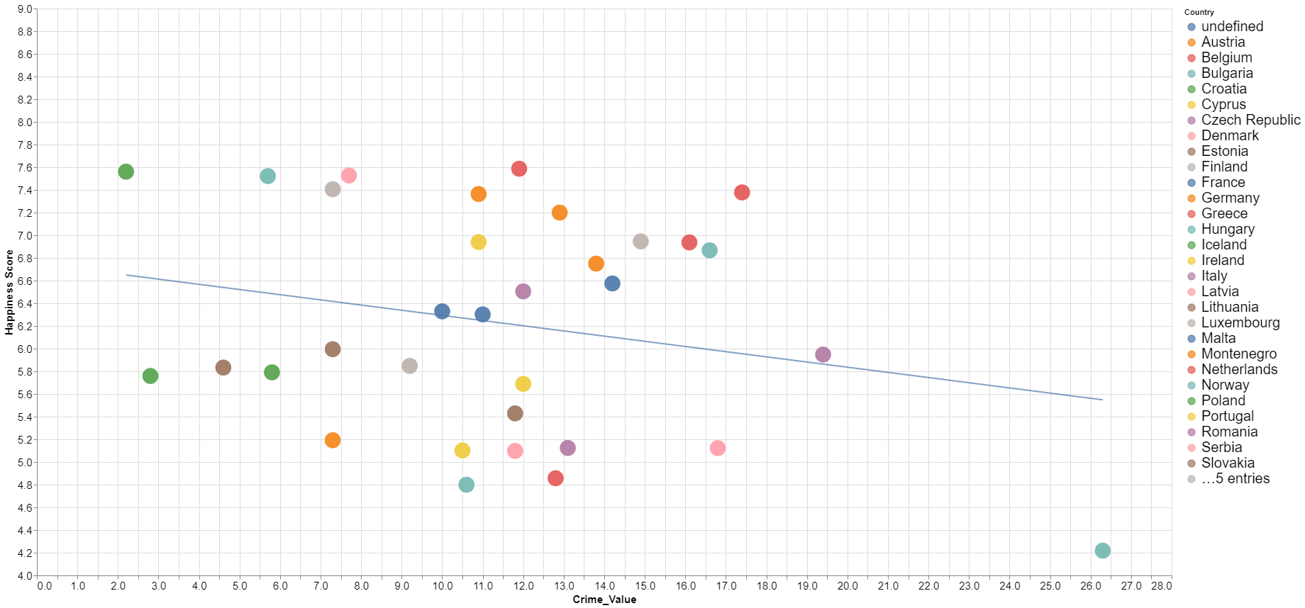
happiness score vs crime
The correlation between the two variables is approx -0.10. That represents a very low negative correlation, which means that the unhappier countries have only a slight tendency to have more crime. It is important to remember that this data makes sense because we are only analysing western and central Europe countries, that tend to have very little crime.
Notes:
file:///C:/Users/pedro/Desktop/World-Happiness-Report/Crime_Happiness.html
Positive correlation: If the number of the correlation is positive. The higher the number, the most it affects
the happiness score making it bigger.
Negative correlation: If the number of the correlation is negative. The lower the number, the most it affects
the happiness score making it smaller.
Basically I'm going to do an analysis on the correlations of every parameter and the happiness score (crucial to
have on the presentation, and then I'm gonna search for correlations above 0.5 and below -0.5, because these
values are not very common in the correlations table and they are worthy of being mentioned if we feel that
they are relevant. There is a small corner case that I'm going to mention about the alcohol and suicides.
I think that before talking about these correlation in the presentation it is important for us to mention that the
happiness score was given by people when asked about how happy they feel from 0 to 10, and our process to create
this correlations matrix (adding the extra parameters that we gathered via API's and Webscraping).
Correlations:
Happiness Score vs GDP - This correlation has a value of aprox. 0.76, which means that the GDP and Hapiness Score
have a HIGH POSITIVE correlation, which makes perfect sense, being money as important as it is in society
to give stability and happiness. Therefore, the GDP contributes a high amount to the increase of the happiness
score.
Happiness Score vs Family Social Support - This correlation has a value of aprox. 0.47, which means a LOW POSITIVE,
almost MODERATE correlation, that indicates that the social support given to family has a slight importance
in the happiness score. This value can be expected to be higher, but we have to consider of course that in Western
Europe countries not everyone needs this kind of support to give stability to their family, therefore it is not
crucial to the increase of the happiness score, but still contributes.
Happiness Score vs Healthy life expectancy - This correlation has a value of aprox. 0.52, which means a MODERATE
POSITIVE correlation with the happiness score. This shows that people care about living longer with quality in
a way that contributes a considerate amount to the increase happiness score.
Happiness Score vs Freedom to make life choices - This correlation has a value of aprox. 0.78, which means a HIGH
POSITIVE correlation with the happiness score. This indicates that people care about the freedom that they have
in society to have plenty of life choices and to be able to make those life choice, and this highly contributes
to the increase of happiness score.
Happiness Score vs Perceptions of corruption - This correlation has a value of aprox. 0.82, which means a HIGH
POSITIVE correlation with the happiness score. This indicates that people care about the trust that they have in
their governments and it highly contributes to the increase happiness score.
Happiness Score vs Generosity - This correlation has a value of aprox. 0.63, which means a MODERATE POSITIVE
correlation with the happiness score. This indicates that people care about the feeling of generosity in their
country, and this contributes a considerate amount to the increase of the happiness score.
Happiness Score vs Alcohol - This correlation has a value of aprox. -0.22, which means a VERY LOW NEGATIVE
correlation, that means that the quantity of alcohol that people consume in each country contributes very lowly
to the decrease of the happiness score.
Happiness Score vs Crime - This correlation has a value of aprox. -0.10, which means a VERY LOW NEGATIVE
correlation, that means that the crime existent in the country contributes very lowly to the descrease of the
happiness score. Again is worth mentioning that we are dealing with countries from Western Europe, that usually
tend to have small tendencies for crime.
Happiness Score vs Suicide - This correlation has a value of aprox. 0.04, which means a NON-EXISTENT correlation
with the happiness score.
Happiness Score vs Hours of Sun - This correlation has a value of aprox. -0.53, which means a MODERATE NEGATIVE
correlation. This correlation means that the hours of sun contribute a moderate amount to the decrease of the
happiness score. This may seem wrong but it makes sense due to the fact of the happiness score being much higher
in countries located in the north of Europe that have much less hours of sun than countries located more towards
the south.
WORHTY MENTIONS:
GDP per capita vs Freedom vs Perceptions of corruption vs Generosity -> There are positive moderate and high
correlations between all of these parameters.
Hours of sun vs Suicide -> There is a moderate negative correlation which means that countries that have less
hours of sun tend to have more suicides and vice-versa.
Suicide vs Alcohol -> There is a very "close to moderate" correlation which means that the countrys that consume
more alcohol tend to have more suicides and vice-versa.

Slide 9
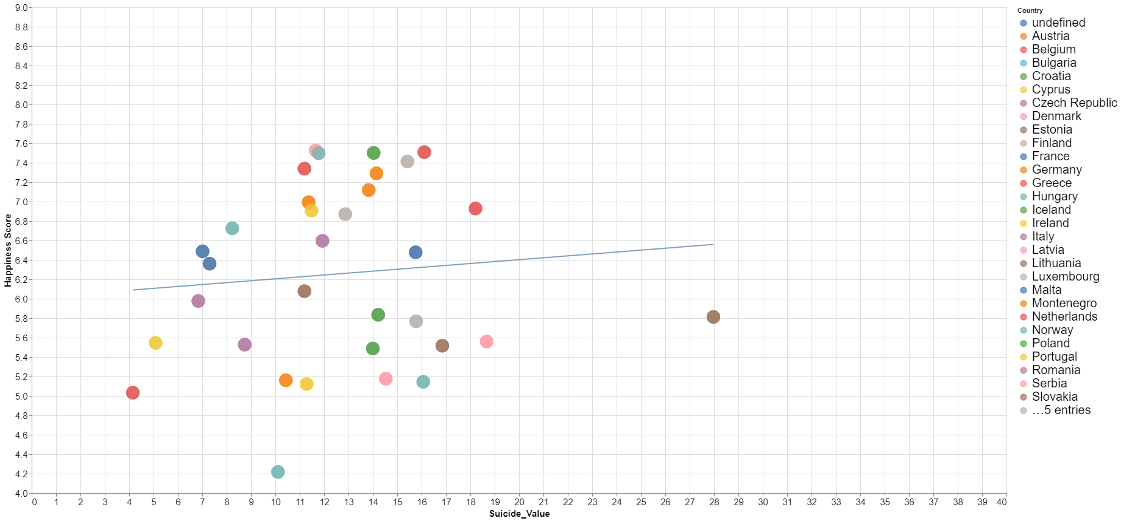
happiness score vs suicide
The correlation between the two variables is approx 0.04, which means that there isn’t any correlation between the happiness score and the suicide rates.
Notes:
file:///C:/Users/pedro/Desktop/World-Happiness-Report/Suicide_Year_Happiness.html
Positive correlation: If the number of the correlation is positive. The higher the number, the most it affects
the happiness score making it bigger.
Negative correlation: If the number of the correlation is negative. The lower the number, the most it affects
the happiness score making it smaller.
Basically I'm going to do an analysis on the correlations of every parameter and the happiness score (crucial to
have on the presentation, and then I'm gonna search for correlations above 0.5 and below -0.5, because these
values are not very common in the correlations table and they are worthy of being mentioned if we feel that
they are relevant. There is a small corner case that I'm going to mention about the alcohol and suicides.
I think that before talking about these correlation in the presentation it is important for us to mention that the
happiness score was given by people when asked about how happy they feel from 0 to 10, and our process to create
this correlations matrix (adding the extra parameters that we gathered via API's and Webscraping).
Correlations:
Happiness Score vs GDP - This correlation has a value of aprox. 0.76, which means that the GDP and Hapiness Score
have a HIGH POSITIVE correlation, which makes perfect sense, being money as important as it is in society
to give stability and happiness. Therefore, the GDP contributes a high amount to the increase of the happiness
score.
Happiness Score vs Family Social Support - This correlation has a value of aprox. 0.47, which means a LOW POSITIVE,
almost MODERATE correlation, that indicates that the social support given to family has a slight importance
in the happiness score. This value can be expected to be higher, but we have to consider of course that in Western
Europe countries not everyone needs this kind of support to give stability to their family, therefore it is not
crucial to the increase of the happiness score, but still contributes.
Happiness Score vs Healthy life expectancy - This correlation has a value of aprox. 0.52, which means a MODERATE
POSITIVE correlation with the happiness score. This shows that people care about living longer with quality in
a way that contributes a considerate amount to the increase happiness score.
Happiness Score vs Freedom to make life choices - This correlation has a value of aprox. 0.78, which means a HIGH
POSITIVE correlation with the happiness score. This indicates that people care about the freedom that they have
in society to have plenty of life choices and to be able to make those life choice, and this highly contributes
to the increase of happiness score.
Happiness Score vs Perceptions of corruption - This correlation has a value of aprox. 0.82, which means a HIGH
POSITIVE correlation with the happiness score. This indicates that people care about the trust that they have in
their governments and it highly contributes to the increase happiness score.
Happiness Score vs Generosity - This correlation has a value of aprox. 0.63, which means a MODERATE POSITIVE
correlation with the happiness score. This indicates that people care about the feeling of generosity in their
country, and this contributes a considerate amount to the increase of the happiness score.
Happiness Score vs Alcohol - This correlation has a value of aprox. -0.22, which means a VERY LOW NEGATIVE
correlation, that means that the quantity of alcohol that people consume in each country contributes very lowly
to the decrease of the happiness score.
Happiness Score vs Crime - This correlation has a value of aprox. -0.10, which means a VERY LOW NEGATIVE
correlation, that means that the crime existent in the country contributes very lowly to the descrease of the
happiness score. Again is worth mentioning that we are dealing with countries from Western Europe, that usually
tend to have small tendencies for crime.
Happiness Score vs Suicide - This correlation has a value of aprox. 0.04, which means a NON-EXISTENT correlation
with the happiness score.
Happiness Score vs Hours of Sun - This correlation has a value of aprox. -0.53, which means a MODERATE NEGATIVE
correlation. This correlation means that the hours of sun contribute a moderate amount to the decrease of the
happiness score. This may seem wrong but it makes sense due to the fact of the happiness score being much higher
in countries located in the north of Europe that have much less hours of sun than countries located more towards
the south.
WORHTY MENTIONS:
GDP per capita vs Freedom vs Perceptions of corruption vs Generosity -> There are positive moderate and high
correlations between all of these parameters.
Hours of sun vs Suicide -> There is a moderate negative correlation which means that countries that have less
hours of sun tend to have more suicides and vice-versa.
Suicide vs Alcohol -> There is a very "close to moderate" correlation which means that the countrys that consume
more alcohol tend to have more suicides and vice-versa.

Slide 10
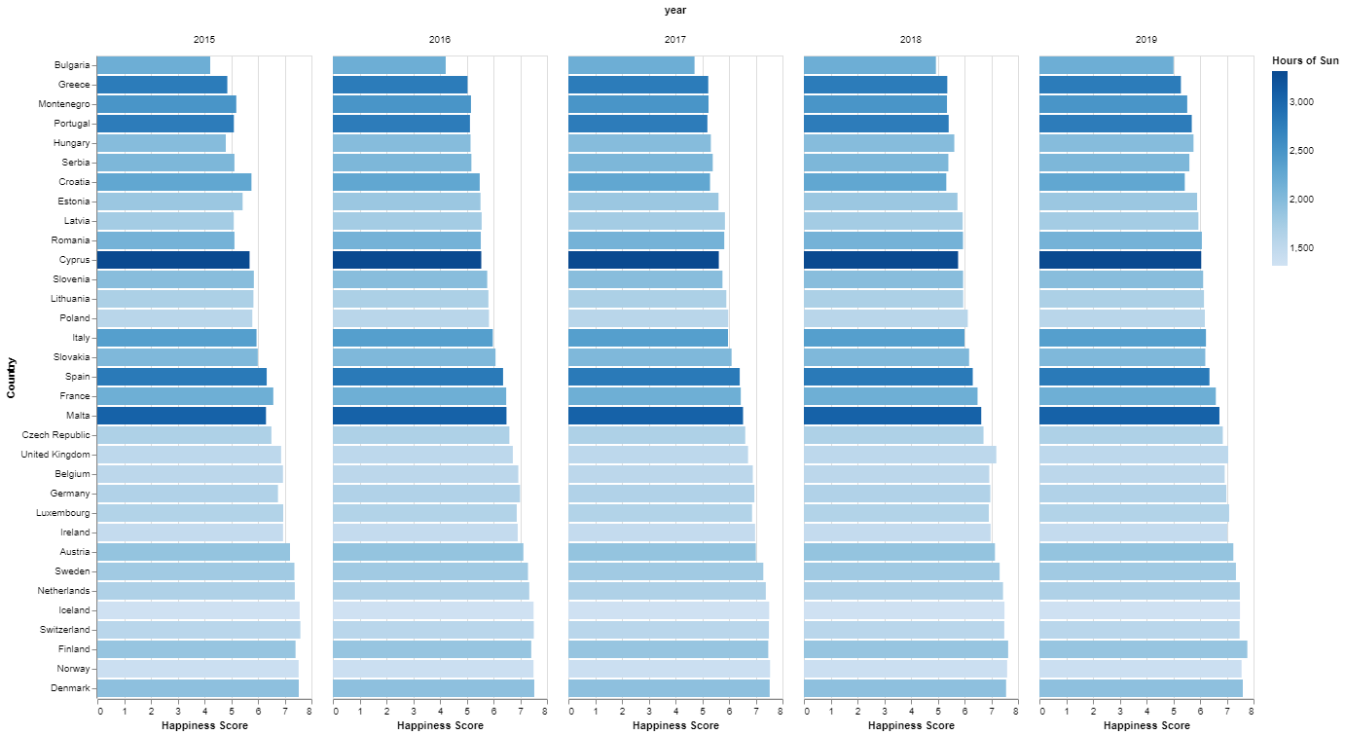
happiness score vs hours of sun
The correlation between the two variables is approx -0.53. That represents a moderate negative correlation, which means that the happier countries have a considerate tendency to have less hours of sun per year. This makes sense because the countries that have higher happiness scores, are usually located more to the north and center of europe.
Notes:
Positive correlation: If the number of the correlation is positive. The higher the number, the most it affects
the happiness score making it bigger.
Negative correlation: If the number of the correlation is negative. The lower the number, the most it affects
the happiness score making it smaller.
Basically I'm going to do an analysis on the correlations of every parameter and the happiness score (crucial to
have on the presentation, and then I'm gonna search for correlations above 0.5 and below -0.5, because these
values are not very common in the correlations table and they are worthy of being mentioned if we feel that
they are relevant. There is a small corner case that I'm going to mention about the alcohol and suicides.
I think that before talking about these correlation in the presentation it is important for us to mention that the
happiness score was given by people when asked about how happy they feel from 0 to 10, and our process to create
this correlations matrix (adding the extra parameters that we gathered via API's and Webscraping).
Correlations:
Happiness Score vs GDP - This correlation has a value of aprox. 0.76, which means that the GDP and Hapiness Score
have a HIGH POSITIVE correlation, which makes perfect sense, being money as important as it is in society
to give stability and happiness. Therefore, the GDP contributes a high amount to the increase of the happiness
score.
Happiness Score vs Family Social Support - This correlation has a value of aprox. 0.47, which means a LOW POSITIVE,
almost MODERATE correlation, that indicates that the social support given to family has a slight importance
in the happiness score. This value can be expected to be higher, but we have to consider of course that in Western
Europe countries not everyone needs this kind of support to give stability to their family, therefore it is not
crucial to the increase of the happiness score, but still contributes.
Happiness Score vs Healthy life expectancy - This correlation has a value of aprox. 0.52, which means a MODERATE
POSITIVE correlation with the happiness score. This shows that people care about living longer with quality in
a way that contributes a considerate amount to the increase happiness score.
Happiness Score vs Freedom to make life choices - This correlation has a value of aprox. 0.78, which means a HIGH
POSITIVE correlation with the happiness score. This indicates that people care about the freedom that they have
in society to have plenty of life choices and to be able to make those life choice, and this highly contributes
to the increase of happiness score.
Happiness Score vs Perceptions of corruption - This correlation has a value of aprox. 0.82, which means a HIGH
POSITIVE correlation with the happiness score. This indicates that people care about the trust that they have in
their governments and it highly contributes to the increase happiness score.
Happiness Score vs Generosity - This correlation has a value of aprox. 0.63, which means a MODERATE POSITIVE
correlation with the happiness score. This indicates that people care about the feeling of generosity in their
country, and this contributes a considerate amount to the increase of the happiness score.
Happiness Score vs Alcohol - This correlation has a value of aprox. -0.22, which means a VERY LOW NEGATIVE
correlation, that means that the quantity of alcohol that people consume in each country contributes very lowly
to the decrease of the happiness score.
Happiness Score vs Crime - This correlation has a value of aprox. -0.10, which means a VERY LOW NEGATIVE
correlation, that means that the crime existent in the country contributes very lowly to the descrease of the
happiness score. Again is worth mentioning that we are dealing with countries from Western Europe, that usually
tend to have small tendencies for crime.
Happiness Score vs Suicide - This correlation has a value of aprox. 0.04, which means a NON-EXISTENT correlation
with the happiness score.
Happiness Score vs Hours of Sun - This correlation has a value of aprox. -0.53, which means a MODERATE NEGATIVE
correlation. This correlation means that the hours of sun contribute a moderate amount to the decrease of the
happiness score. This may seem wrong but it makes sense due to the fact of the happiness score being much higher
in countries located in the north of Europe that have much less hours of sun than countries located more towards
the south.
WORHTY MENTIONS:
GDP per capita vs Freedom vs Perceptions of corruption vs Generosity -> There are positive moderate and high
correlations between all of these parameters.
Hours of sun vs Suicide -> There is a moderate negative correlation which means that countries that have less
hours of sun tend to have more suicides and vice-versa.
Suicide vs Alcohol -> There is a very "close to moderate" correlation which means that the countrys that consume
more alcohol tend to have more suicides and vice-versa.

Slide 11
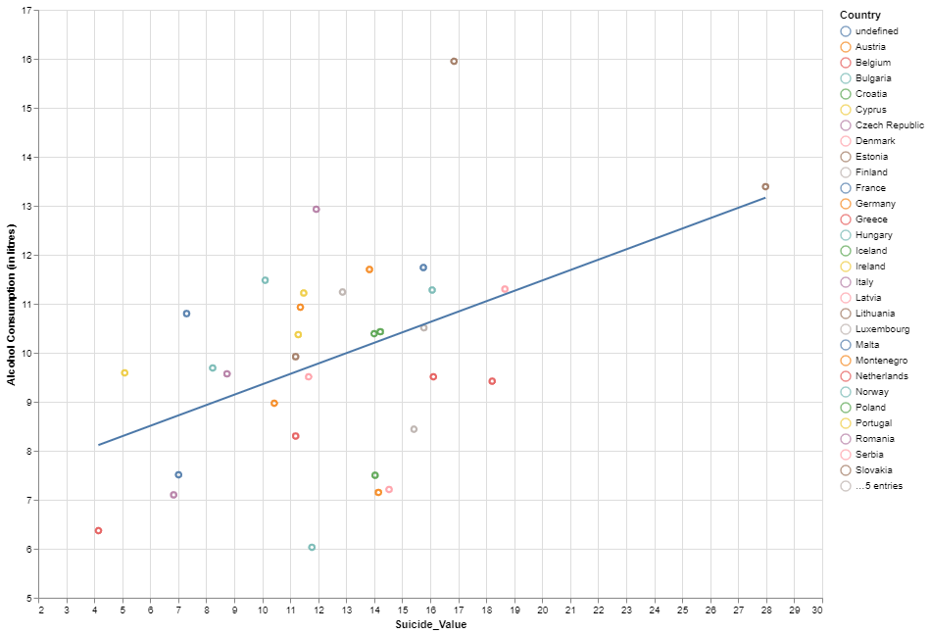
suicide vs alcohol consumption
The correlation between the two variables is approx 0.46. That represents a low but very close to moderate correlation, which means that there is considerate tendency for countries with higher suicide values to consume more alcohol. This is worth mentioning because these two variables can be related to depression.
Notes:
Positive correlation: If the number of the correlation is positive. The higher the number, the most it affects
the happiness score making it bigger.
Negative correlation: If the number of the correlation is negative. The lower the number, the most it affects
the happiness score making it smaller.
Basically I'm going to do an analysis on the correlations of every parameter and the happiness score (crucial to
have on the presentation, and then I'm gonna search for correlations above 0.5 and below -0.5, because these
values are not very common in the correlations table and they are worthy of being mentioned if we feel that
they are relevant. There is a small corner case that I'm going to mention about the alcohol and suicides.
I think that before talking about these correlation in the presentation it is important for us to mention that the
happiness score was given by people when asked about how happy they feel from 0 to 10, and our process to create
this correlations matrix (adding the extra parameters that we gathered via API's and Webscraping).
Correlations:
Happiness Score vs GDP - This correlation has a value of aprox. 0.76, which means that the GDP and Hapiness Score
have a HIGH POSITIVE correlation, which makes perfect sense, being money as important as it is in society
to give stability and happiness. Therefore, the GDP contributes a high amount to the increase of the happiness
score.
Happiness Score vs Family Social Support - This correlation has a value of aprox. 0.47, which means a LOW POSITIVE,
almost MODERATE correlation, that indicates that the social support given to family has a slight importance
in the happiness score. This value can be expected to be higher, but we have to consider of course that in Western
Europe countries not everyone needs this kind of support to give stability to their family, therefore it is not
crucial to the increase of the happiness score, but still contributes.
Happiness Score vs Healthy life expectancy - This correlation has a value of aprox. 0.52, which means a MODERATE
POSITIVE correlation with the happiness score. This shows that people care about living longer with quality in
a way that contributes a considerate amount to the increase happiness score.
Happiness Score vs Freedom to make life choices - This correlation has a value of aprox. 0.78, which means a HIGH
POSITIVE correlation with the happiness score. This indicates that people care about the freedom that they have
in society to have plenty of life choices and to be able to make those life choice, and this highly contributes
to the increase of happiness score.
Happiness Score vs Perceptions of corruption - This correlation has a value of aprox. 0.82, which means a HIGH
POSITIVE correlation with the happiness score. This indicates that people care about the trust that they have in
their governments and it highly contributes to the increase happiness score.
Happiness Score vs Generosity - This correlation has a value of aprox. 0.63, which means a MODERATE POSITIVE
correlation with the happiness score. This indicates that people care about the feeling of generosity in their
country, and this contributes a considerate amount to the increase of the happiness score.
Happiness Score vs Alcohol - This correlation has a value of aprox. -0.22, which means a VERY LOW NEGATIVE
correlation, that means that the quantity of alcohol that people consume in each country contributes very lowly
to the decrease of the happiness score.
Happiness Score vs Crime - This correlation has a value of aprox. -0.10, which means a VERY LOW NEGATIVE
correlation, that means that the crime existent in the country contributes very lowly to the descrease of the
happiness score. Again is worth mentioning that we are dealing with countries from Western Europe, that usually
tend to have small tendencies for crime.
Happiness Score vs Suicide - This correlation has a value of aprox. 0.04, which means a NON-EXISTENT correlation
with the happiness score.
Happiness Score vs Hours of Sun - This correlation has a value of aprox. -0.53, which means a MODERATE NEGATIVE
correlation. This correlation means that the hours of sun contribute a moderate amount to the decrease of the
happiness score. This may seem wrong but it makes sense due to the fact of the happiness score being much higher
in countries located in the north of Europe that have much less hours of sun than countries located more towards
the south.
WORHTY MENTIONS:
GDP per capita vs Freedom vs Perceptions of corruption vs Generosity -> There are positive moderate and high
correlations between all of these parameters.
Hours of sun vs Suicide -> There is a moderate negative correlation which means that countries that have less
hours of sun tend to have more suicides and vice-versa.
Suicide vs Alcohol -> There is a very "close to moderate" correlation which means that the countrys that consume
more alcohol tend to have more suicides and vice-versa.

Slide 12
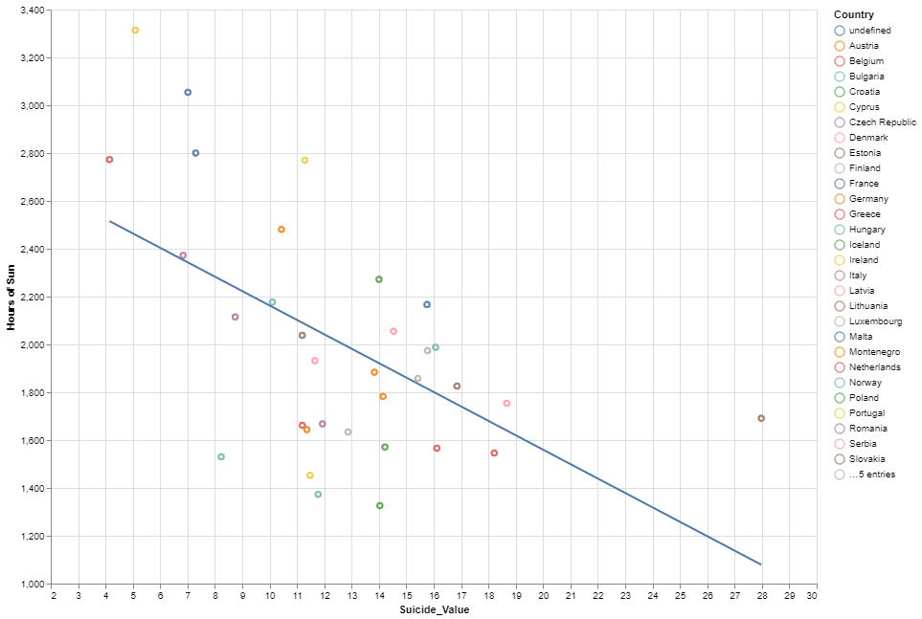
suicide vs Hours of sun
The correlation between the two variables is approx -0.51. That represents a moderate negative correlation, which means that countries with less hours of sun have a considerate tendency to have higher suicide rates.
Notes:
Positive correlation: If the number of the correlation is positive. The higher the number, the most it affects
the happiness score making it bigger.
Negative correlation: If the number of the correlation is negative. The lower the number, the most it affects
the happiness score making it smaller.
Basically I'm going to do an analysis on the correlations of every parameter and the happiness score (crucial to
have on the presentation, and then I'm gonna search for correlations above 0.5 and below -0.5, because these
values are not very common in the correlations table and they are worthy of being mentioned if we feel that
they are relevant. There is a small corner case that I'm going to mention about the alcohol and suicides.
I think that before talking about these correlation in the presentation it is important for us to mention that the
happiness score was given by people when asked about how happy they feel from 0 to 10, and our process to create
this correlations matrix (adding the extra parameters that we gathered via API's and Webscraping).
Correlations:
Happiness Score vs GDP - This correlation has a value of aprox. 0.76, which means that the GDP and Hapiness Score
have a HIGH POSITIVE correlation, which makes perfect sense, being money as important as it is in society
to give stability and happiness. Therefore, the GDP contributes a high amount to the increase of the happiness
score.
Happiness Score vs Family Social Support - This correlation has a value of aprox. 0.47, which means a LOW POSITIVE,
almost MODERATE correlation, that indicates that the social support given to family has a slight importance
in the happiness score. This value can be expected to be higher, but we have to consider of course that in Western
Europe countries not everyone needs this kind of support to give stability to their family, therefore it is not
crucial to the increase of the happiness score, but still contributes.
Happiness Score vs Healthy life expectancy - This correlation has a value of aprox. 0.52, which means a MODERATE
POSITIVE correlation with the happiness score. This shows that people care about living longer with quality in
a way that contributes a considerate amount to the increase happiness score.
Happiness Score vs Freedom to make life choices - This correlation has a value of aprox. 0.78, which means a HIGH
POSITIVE correlation with the happiness score. This indicates that people care about the freedom that they have
in society to have plenty of life choices and to be able to make those life choice, and this highly contributes
to the increase of happiness score.
Happiness Score vs Perceptions of corruption - This correlation has a value of aprox. 0.82, which means a HIGH
POSITIVE correlation with the happiness score. This indicates that people care about the trust that they have in
their governments and it highly contributes to the increase happiness score.
Happiness Score vs Generosity - This correlation has a value of aprox. 0.63, which means a MODERATE POSITIVE
correlation with the happiness score. This indicates that people care about the feeling of generosity in their
country, and this contributes a considerate amount to the increase of the happiness score.
Happiness Score vs Alcohol - This correlation has a value of aprox. -0.22, which means a VERY LOW NEGATIVE
correlation, that means that the quantity of alcohol that people consume in each country contributes very lowly
to the decrease of the happiness score.
Happiness Score vs Crime - This correlation has a value of aprox. -0.10, which means a VERY LOW NEGATIVE
correlation, that means that the crime existent in the country contributes very lowly to the descrease of the
happiness score. Again is worth mentioning that we are dealing with countries from Western Europe, that usually
tend to have small tendencies for crime.
Happiness Score vs Suicide - This correlation has a value of aprox. 0.04, which means a NON-EXISTENT correlation
with the happiness score.
Happiness Score vs Hours of Sun - This correlation has a value of aprox. -0.53, which means a MODERATE NEGATIVE
correlation. This correlation means that the hours of sun contribute a moderate amount to the decrease of the
happiness score. This may seem wrong but it makes sense due to the fact of the happiness score being much higher
in countries located in the north of Europe that have much less hours of sun than countries located more towards
the south.
WORHTY MENTIONS:
GDP per capita vs Freedom vs Perceptions of corruption vs Generosity -> There are positive moderate and high
correlations between all of these parameters.
Hours of sun vs Suicide -> There is a moderate negative correlation which means that countries that have less
hours of sun tend to have more suicides and vice-versa.
Suicide vs Alcohol -> There is a very "close to moderate" correlation which means that the countrys that consume
more alcohol tend to have more suicides and vice-versa.

Slide 13
Conclusion
With this Project we were able to find out a lot about what makes countries have higher or lower Happiness Scores, and how much do those factors contribute to the actual happiness of the countries studied.
It is worthy of mentioning that the data we found was very reliable because we got all of the results that we expected to get in the main correlations that we focused on, so maybe in the future we are able to predict the happiness score in the future years using machine learning ( maybe ? )

Slide 14


